Slide 1
Module 1 - Introduction to Cloud and Azure
Lesson 1: Cloud technology overview
Lesson 2: Overview of Azure
Lesson 3: Managing Azure with the Azure portal
Lesson 4: Managing Azure with Windows PowerShell
Lesson 5: Managing Azure with Azure CLI
Lesson 6: Overview of Azure deployment models
Lesson 7: Managing and monitoring Azure resources

Slide 2
Module 1 - Lesson 1 : Cloud technology overview
What is Cloud Computing?
Cloud Computing can be defined as delivering computing power( CPU, RAM, Network Speeds, Storage OS software)
a service over a network (usually on the internet) rather than physically having the computing resources at the
customer location.
Example: AWS, Azure, Google Cloud
Cloud Computing provides us a means by which we can access the applications as utilities, over the Internet.
It allows us to create, configure, and customize applications online.
With Cloud Computing users can access database resources via the internet from anywhere for as long as they
need without worrying about any maintenance or management of actual resources

Slide 3
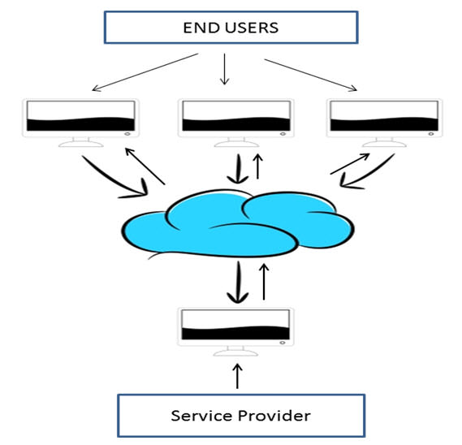
Why the Name Cloud?
The term “Cloud” came from a network design that was used by network engineers to represent the location of
various network devices and there inter-connection. The shape of this network design was like a cloud.

Slide 4
Why Cloud Computing?
With increase in computer and Mobile user’s, data storage has become a priority in all fields. Large and small scale businesses today thrive on their data & they spent a huge amount of money to maintain this data. It requires a strong IT support and a storage hub. Not all businesses can afford high cost of in-house IT infrastructure and back up support services. For them Cloud Computing is a cheaper solution. Perhaps its efficiency in storing data, computation and less maintenance cost has succeeded to attract even bigger businesses as well.
Cloud computing decreases the hardware and software demand from the user’s side. The only thing that user must be able to run is the cloud computing systems interface software, which can be as simple as Web browser, and the Cloud network takes care of the rest. We all have experienced cloud computing at some instant of time, some of the popular cloud services we have used or we are still using are mail services like gmail, hotmail or yahoo etc.
While accessing e-mail service our data is stored on cloud server and not on our computer. The technology and infrastructure behind the cloud is invisible. It is less important whether cloud services are based on HTTP, XML, Ruby, PHP or other specific technologies as far as it is user friendly and functional. An individual user can connect to cloud system from his/her own devices like desktop, laptop or mobile.

Slide 5
Cloud computing harnesses small business effectively having limited resources, it gives small businesses access to the technologies that previously were out of their reach. Cloud computing helps small businesses to convert their maintenance cost into profit. Let’s see how?
In an in-house IT server, you have to pay a lot of attention and ensure that there are no flaws into the system so that it runs smoothly. And in case of any technical glitch you are completely responsible; it will seek a lot of attention, time and money for repair. Whereas, in cloud computing, the service provider takes the complete responsibility of the complication and the technical faults.
Cloud computing is a model for enabling ubiquitous, convenient, on-demand network access to a shared pool of configurable computing resources (e.g., networks, servers, storage, applications, and services) that can be rapidly provisioned and released with minimal management effort or service provider interaction. This cloud model is composed of five essential characteristics, three service models, and four deployment models.

Slide 6
Benefits of Cloud Computing
The potential for cost saving is the major reason of cloud services adoption by many organizations. Cloud computing gives the freedom to use services as per the requirement and pay only for what you use. Due to cloud computing it has become possible to run IT operations as a outsourced unit without much in-house resources.
Following are the benefits of cloud computing:
Lower IT infrastructure and computer costs for users
Improved performance
Fewer Maintenance issues
Instant software updates
Improved compatibility between Operating systems
Backup and recovery
Performance and Scalability
Increased storage capacity
Increase data safety

Slide 7
Cloud Computing Patterns
On and Off
Inactivity
Period
On and off workloads (e.g. batch job)
Over provisioned capacity is wasted
Time to market can be cumbersome
Compute
t
Growing Fast
Compute
Successful services needs to grow/scale
Keeping up with growth is a big IT challenge
Cannot provision hardware fast enough
t
Unpredictable Bursting
Compute
Unexpected/unplanned peak in demand
Sudden spike impacts performance
Cannot over provision for extreme cases
t
Predictable Bursting
Compute
Services with micro seasonality trends
Peaks due to periodic increased demand
IT complexity and wasted capacity
t

Slide 8
Elasticity-Provision Vs Workload
Cloud provides on-demand, scale out and in, compute, storage and network resources
Provisioning Benefit: Reduced Costs and Improved User Experience
Demand
Provision
Overprovisioned
Under provisioned
Self Provision
Cloud Provisioning
Resource
Resource
Time
Time

Slide 9
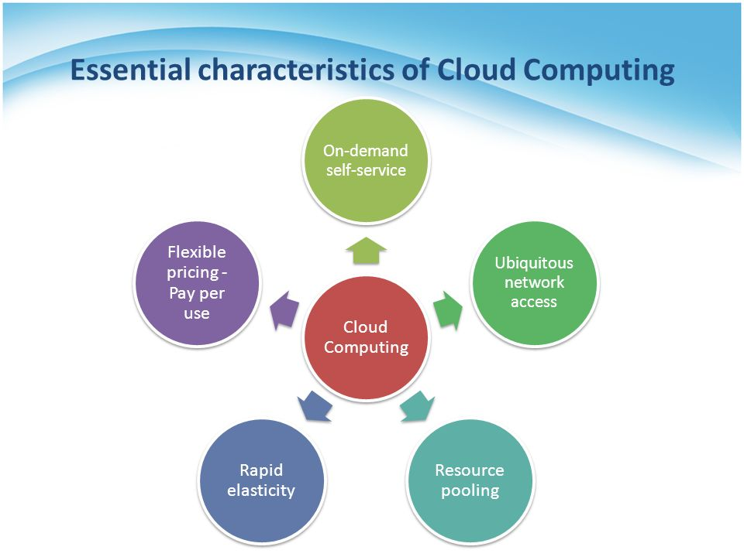
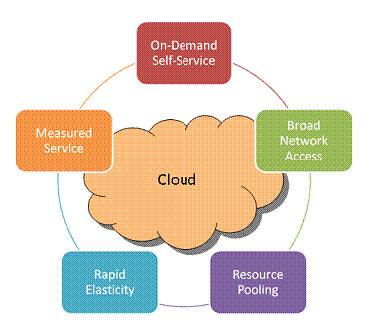
Essential Characteristics:
Cloud have five types of essential characteristics: On-demand self-service, Broad network access, Resource pooling, Rapid elasticity,
Measured service.

Slide 10
Five Essential Characteristics:
On-demand self-service: A consumer can unilaterally provision computing capabilities, such as server time and network storage, as needed automatically without requiring human interaction with each service provider.
Broad network access: Your team can access business management solutions using their smartphones, tablets, laptops, and office computers. They can use these devices wherever they are located with a simple online access point.
This mobility is particularly attractive for businesses so that during business hours or on off-times, employees can stay on top of projects, contracts, and customers whether they are on the road or in the office.
Broad network access includes private clouds that operate within a company’s firewall, public clouds, or a hybrid deployment.
Resource pooling: The cloud enables your employees to enter and use data within the business management software hosted in the cloud at the same time, from any location, and at any time. This is an attractive feature for multiple business offices and field service or sales teams that are usually outside the office.
Rapid elasticity: If anything, the cloud is flexible and scalable to suit your immediate business needs. You can quickly and easily add or remove users, software features, and other resources.
Measured service: Going back to the affordable nature of the cloud, you only pay for what you use. You and your cloud provider can measure storage levels, processing, bandwidth, and the number of user accounts and you are billed appropriately. The amount of resources that you may use can be monitored and controlled from both your side and your cloud provider’s side which provides transparency.

Slide 11
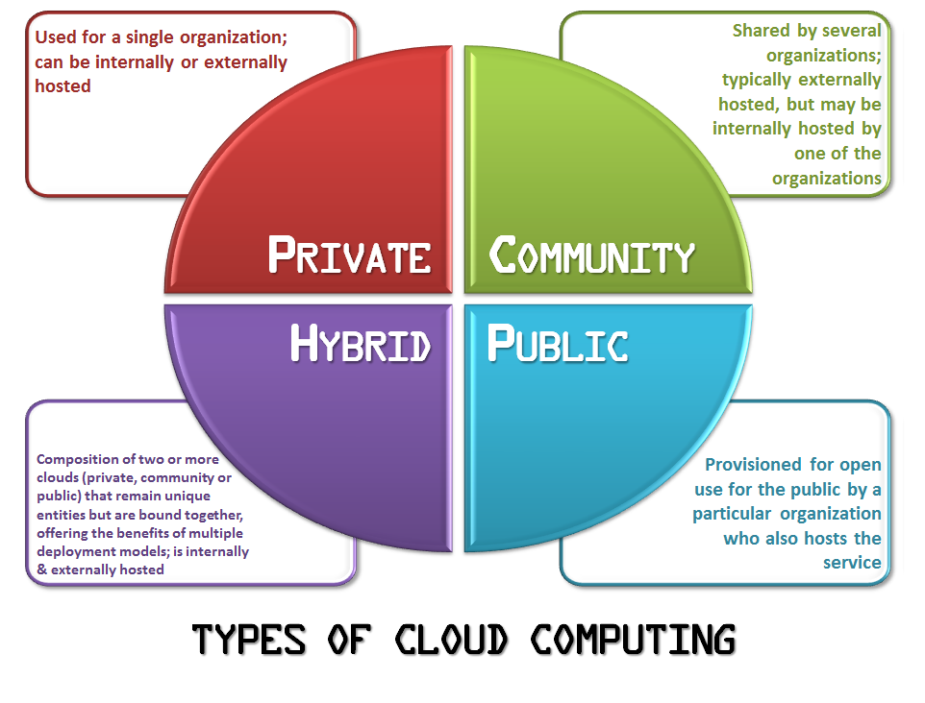
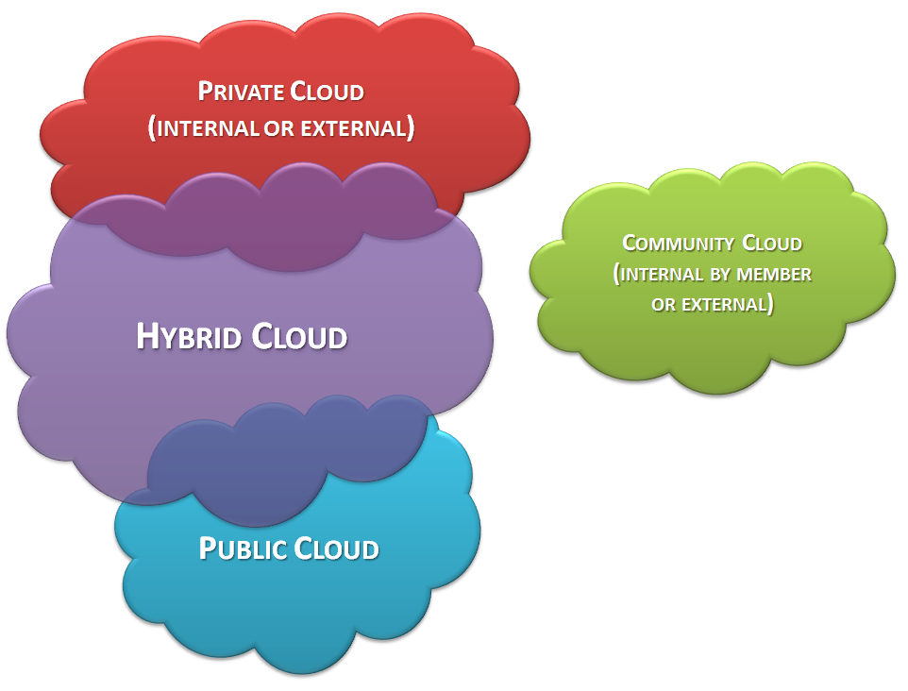
Types of Cloud : Deployment Models
Deployment models define the type of access to the cloud, i.e., how the cloud is located? Cloud can have any of the four types of access: Public, Private, Hybrid and Community.

Slide 12
Four Deployment Models:
Private cloud: The cloud infrastructure is provisioned for exclusive use by a single organization comprising multiple consumers (e.g., business units). It may be owned, managed, and operated by the organization, a third party, or some combination of them, and it may exist on or off premises.
Community cloud: The cloud infrastructure is provisioned for exclusive use by a specific community of consumers from organizations that have shared concerns (e.g., mission, security requirements, policy, and compliance considerations). It may be owned, managed, and operated by one or more of the organizations in the community, a third party, or some combination of them, and it may exist on or off premises.
Public cloud: The cloud infrastructure is provisioned for open use by the general public. It may be owned, managed, and operated by a business, academic, or government organization, or some combination of them. It exists on the premises of the cloud provider.
Hybrid cloud: The cloud infrastructure is a composition of two or more distinct cloud infrastructures (private, community, or public) that remain unique entities, but are bound together by standardized or proprietary technology that enables data and application portability (e.g., cloud bursting for load balancing between clouds)

Slide 13
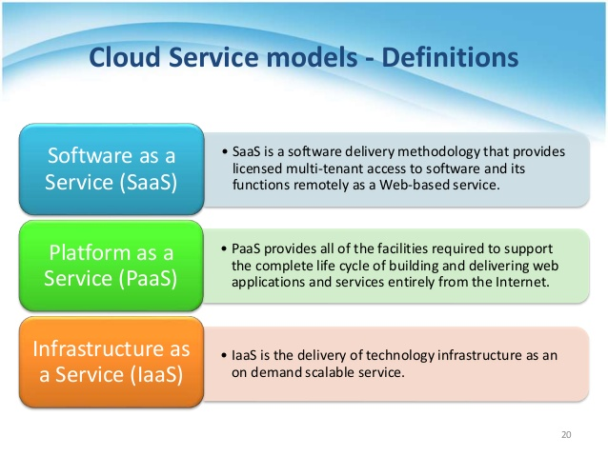
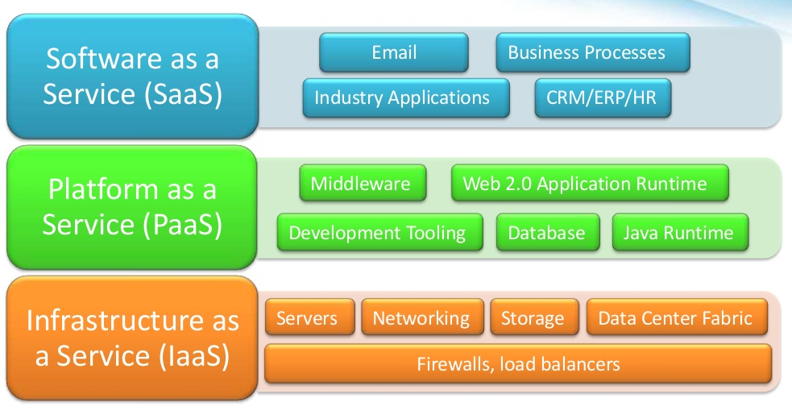
Service Models
Cloud have three types of Service Models: Software as a Service (SaaS), Platform as a Service (PaaS),
Infrastructure as a Service (IaaS)

Slide 14
Three Service Models:
SaaS (Software as a Service): SaaS or software as a service is a software distribution model in which applications are hosted by a vendor or service provider and made available to customers over a network (internet). SaaS is becoming an increasingly prevalent delivery model as underlying technologies that supports Service Oriented Architecture (SOA) or Web Services.
Through internet this service is available to users anywhere in the world. Traditionally, software application needed to be purchased upfront &then installed it onto your computer. SaaS users on the other hand, instead of purchasing the software subscribes to it, usually on monthly basis via internet.
Anyone who needs an access to a particular piece of software can be subscribe as a user, whether it is one or two people or every thousands of employees in a corporation. SaaS is compatible with all internet enabled devices.
Many important tasks like accounting, sales, invoicing and planning all can be performed using SaaS.
PaaS (Platform as a Service): Platform as a service, is referred as PaaS, it provides a platform and environment to allow developers to build applications and services. This service is hosted in the cloud and accessed by the users via internet.
To understand in a simple terms, let compare this with painting a picture, where you are provided with paint colors, different paint brushes and paper by your school teacher and you just have to draw a beautiful picture using those tools.
PaaS services are constantly updated & new features added. Software developers, web developers and business can benefit from PaaS. It provides platform to support application development. It includes software support and management services, storage, networking, deploying, testing, collaborating, hosting and maintaining applications.

Slide 15
IaaS (Infrastructure as a Service): IaaS (Infrastructure As A Service) is one of the fundamental service model of cloud computing alongside PaaS( Platform as a Service). It provides access to computing resources in a virtualized environment “the cloud” on internet. It provides computing infrastructure like virtual server space, network connections, bandwidth, load balancers and IP addresses.
The pool of hardware resource is extracted from multiple servers and networks usually distributed across numerous data centers. This provides redundancy and reliability to IaaS. IaaS(Infrastructure as a service) is a complete package for computing. For small scale businesses who are looking for cutting cost on IT infrastructure, IaaS is one of the solutions.
Annually a lot of money is spent in maintenance and buying new components like hard-drives, network connections, external storage device etc. which a business owner could have saved for other expenses by using IaaS.

Slide 16
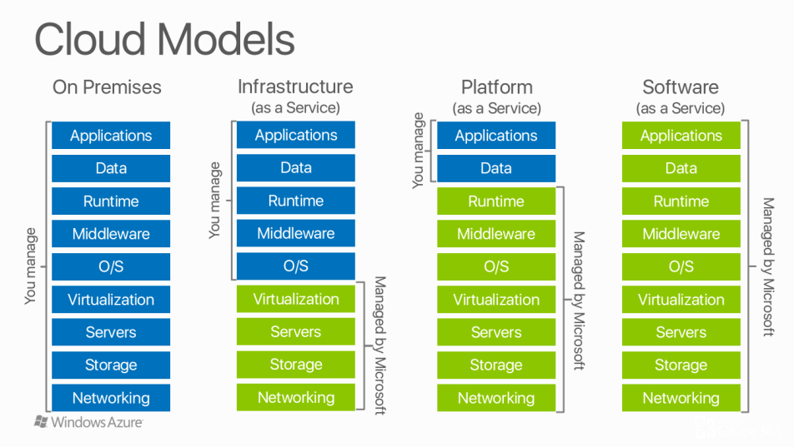

Slide 17
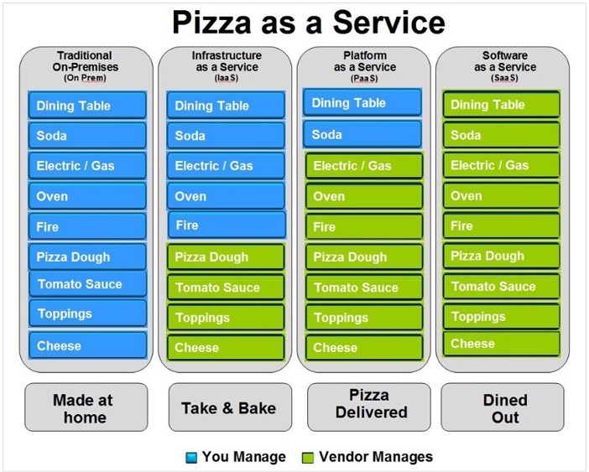
Understanding the Cloud Computing Stack (IaaS, PaaS, SaaS)

Slide 18
What is Cloud Computing Architecture?
Let’s have a look into Cloud Computing and see what Cloud Computing is made of. Cloud computing comprises of two components front end and back end. Front end consist client part of cloud computing system. It comprise of interfaces and applications that are required to access the cloud computing platform.
While back end refers to the cloud itself, it comprises of the resources that are required for cloud computing services. It consists of virtual machines, servers, data storage, security mechanism etc. It is under providers control.
Cloud computing distributes the file system that spreads over multiple hard disks and machines. Data is never stored in one place only and in case one unit fails the other will take over automatically. The user disk space is allocated on the distributed file system, while another important component is algorithm for resource allocation. Cloud computing is a strong distributed environment and it heavily depends upon strong algorithm.

Slide 19
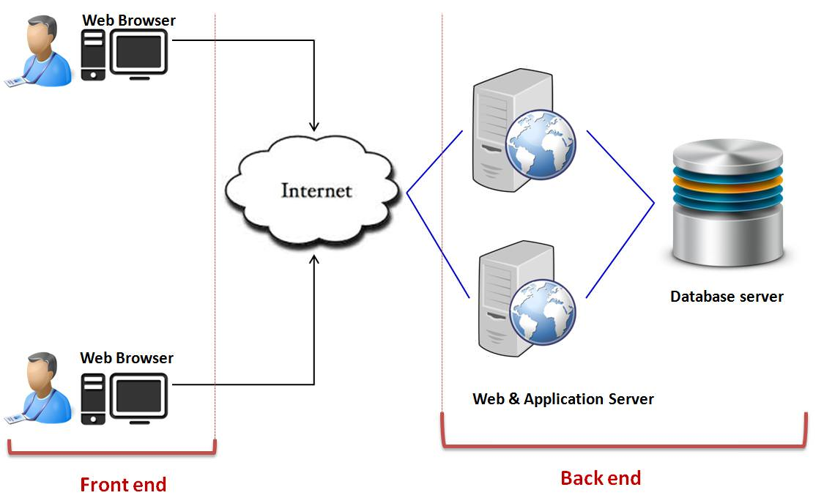

Slide 20
Virtualization and Cloud Computing
The main enabling technology for Cloud Computing is Virtualization. Virtualization is a partitioning of single physical server into multiple logical servers. Once the physical server is divided, each logical server behaves like a physical server and can run an operating system and applications independently. Many popular companies' like VMware and Microsoft provide virtualization services, where instead of using your personal PC for storage and computation, you use their virtual server. They are fast, cost-effective and less time consuming.
For software developers and testers virtualization comes very handy, as it allows developer to write code that runs in many different environments and more importantly to test that code.
Virtualization is mainly used for three main purposes 1) Network Virtualization 2) Server Virtualization 3) Storage Virtualization
Network Virtualization: It is a method of combining the available resources in a network by splitting up the available bandwidth into channels, each of which is independent from the others and each channel is independent of others and can be assigned to a specific server or device in real time.
Storage Virtualization: It is the pooling of physical storage from multiple network storage devices into what appears to be a single storage device that is managed from a central console. Storage virtualization is commonly used in storage area networks (SANs).

Slide 21
Server Virtualization: Server virtualization is the masking of server resources like processors, RAM, operating system etc., from server users. The intention of server virtualization is to increase the resource sharing and reduce the burden and complexity of computation from users.
Virtualization is the key to unlock the Cloud system, what makes virtualization so important for the cloud is that it decouples the software from the hardware. For example, PC’s can use virtual memory to borrow extra memory from the hard disk. Usually hard disk has a lot more space than memory. Although virtual disks are slower than real memory, if managed properly the substitution works perfectly. Likewise, there is software which can imitate an entire computer, which means 1 computer can perform the functions equals to 20 computers.

Slide 22
Module 1 - Lesson 2 : Overview of Azure
Microsoft Azure
• A cloud computing platform by Microsoft
• Was announced by Microsoft back in 2008
• Used to be known as Windows Azure
• Initially offered PaaS services
• Offers over 500 cloud services and growing

Slide 23
Microsoft Azure Datacenters and Regions
• Azure platform is supported by network of Microsoft managed Datacenters
• Azure Datacenters are located in about 50 geographic regions (https://azure.microsoft.com/enca/regions/)
• Each region is geographic group of one or more datacenters
• Is it important to know where the Azure regions are. It is the first consideration you need to make
to deploy any Azure cloud service.
• Azure region pairs – Each Azure region is paired with another region. They are connected directly.
(https://docs.microsoft.com/en-us/azure/best-practices-availability-paired-regions)
• Microsoft Datacenter Tour: https://cloud-platform-assets.azurewebsites.net/datacenter/

Slide 24
Azure Accounts and Subscriptions
• Azure is primarily organized by Accounts and Subscriptions
• Each Account can have multiple subscriptions associated with it
• The primary account delegates privileges at subscription level
• Account administrator is the user created with the account
• Has access to the Azure Account Center (https://account.azure.com/)
• Can create the billing method
• Can create/cancel subscriptions
• Can create/change the subscription level administrator
• To consume Azure services you need subscriptions
• Subscriptions can be personal or organizational
• Subscriptions have isolation of administration & billing
• Separate privileges can be assigned to separate subscriptions
• Subscriptions have quotas and limits (https://docs.microsoft.com/en-us/azure/azuresubscription-service-limits)
• Subscriptions have 2 roles + RBAC
Service Administrator
Co-Administrator

Slide 25
Azure billing
• Azure is a pay-per-use utilization model
• PAYG – Pay As You Go Model – most of you will use this (https://azure.microsoft.com/enus/offers/ms-azr-0003p/)
• Enterprise Agreement
• Azure Compute pre-purchase plan
• Azure Hybrid benefit
• Microsoft reseller
Through benefits:
• MSDN Subscription for development use
• Partners get monthly credits

Slide 26
Azure billing and support options
The most common Azure billing options include:
Pay-As-You-Go
Buy from a Microsoft Reseller
Enterprise agreements

Slide 27
Azure services
• Compute
• Networking
• Storage
• Web+Mobile
• Containers
• Databases
• Analytics
• AI+Machine Learning (ML)
• Internet of Things (IoT)
• Enterprise Integrations
• Security+Identity
• Developer tools
• Management tools
Exhaustive details of all Azure services: https://azure.microsoft.com/en-us/services

Slide 28
Overview of Azure services
Compute
Networking
Data & Storage
Web & Mobile
Virtual Network
Service Fabric
Azure DNS
Container Service
Storage
Application Gateway
Web Apps
DocumentDB
Azure Virtual Machines
Traffic Manager
Mobile Apps
Azure SQL Database
ExpressRoute
Azure Cloud Services
Notification Hub
Load Balancer
StorSimple
Other services
Service Bus
Automation
Azure AD
Scheduler
Azure AD DS
Azure Backup
Key Vault
MFA
Site Recovery
Azure Security Center
Notes:
Provide a high-level overview of the Azure services, breaking them down by category. However, avoid discussing them in detail because it may take a long time.
10979C
1: Getting started with Microsoft Azure

Slide 29
Azure Management Tools
• Azure portal (https://portal.azure.com/)
• Azure classic portal (https://manage.windowsazure.com/)
• Azure PowerShell
• Azure CLI
• Azure Cloud Shell – CLI
• Azure Cloud Shell – PowerShell)
• Visual Studio – Azure SDK

Slide 30
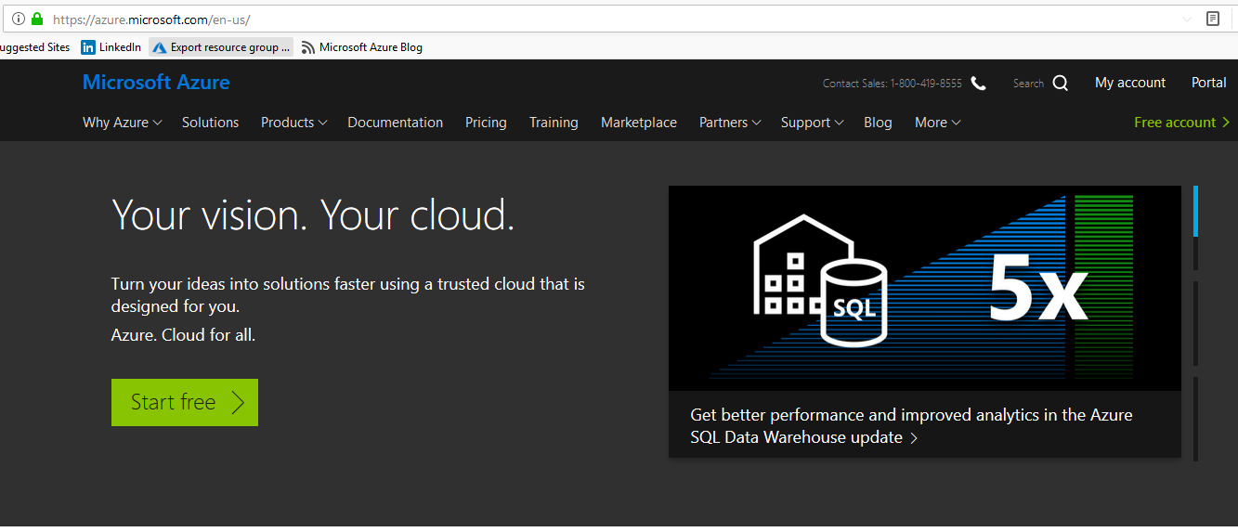
How to Create up a New Microsoft Azure Account
Microsoft Azure offers a free 30-day trial period to all new account holders.
Go to https://www.azure.com and click the green “Start free” button.

Slide 31
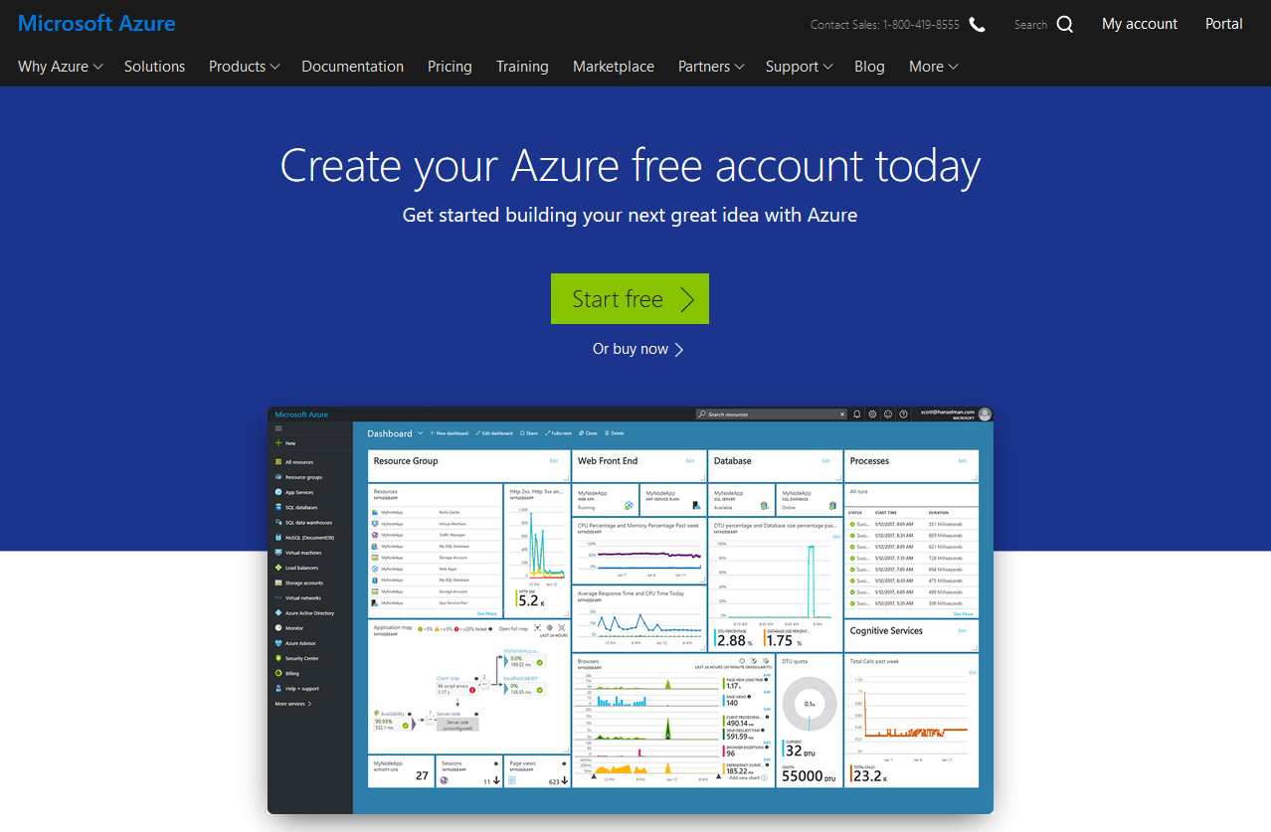
Next, click another “Start free” button.

Slide 32
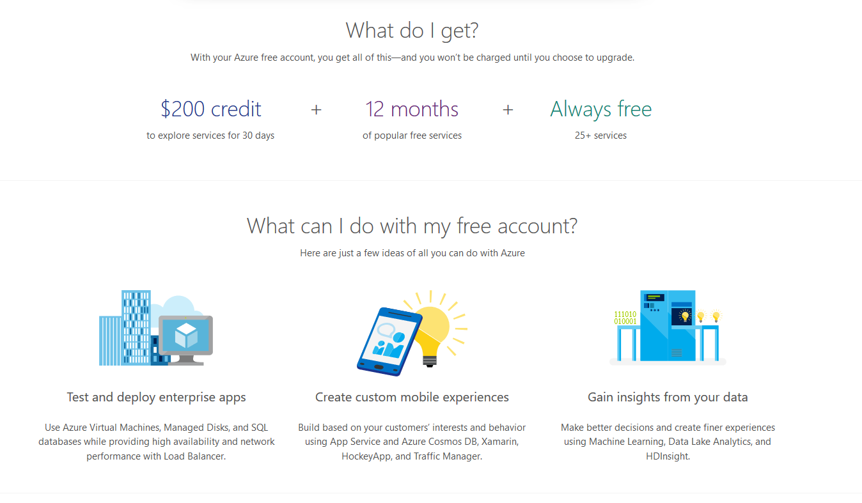

Slide 33
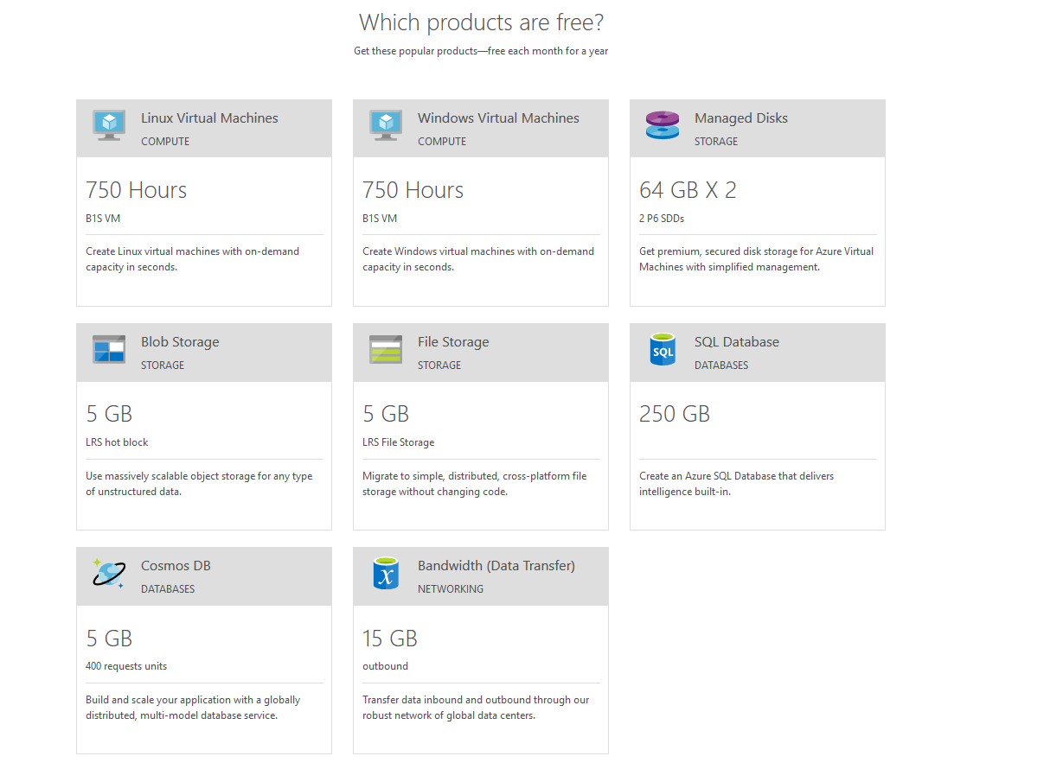

Slide 34
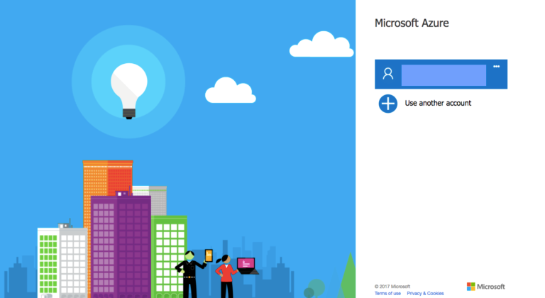
If you already have an account with Microsoft, for example, Office 365, you’ll be prompted to log in.

Slide 35
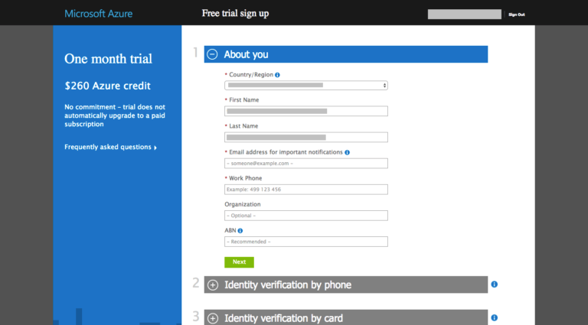
When you log in, some of your details may already be there.

Slide 36
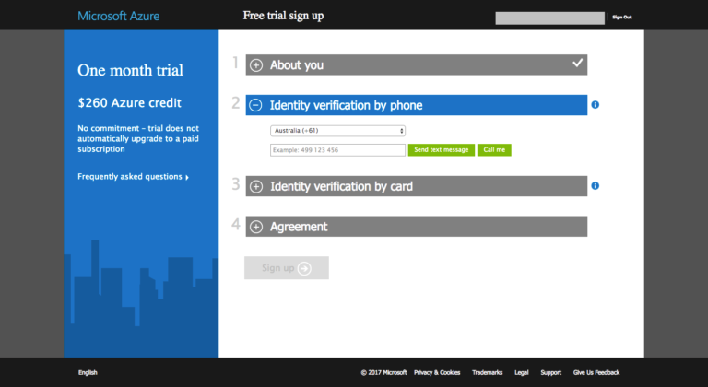
Follow the prompts to verify your account by phone (I used SMS).

Slide 37
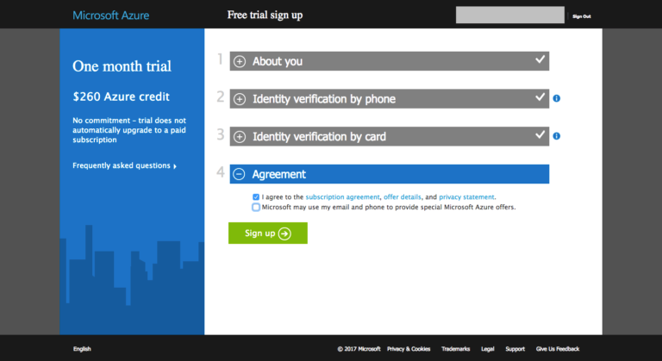
You’ll also need to supply a valid credit card. Prepaid credit cards won’t work — you’ll need a “normal” credit or debit card. There is no charge involved with the setting up of a trial account. Microsoft just wants to see your card to verify your identity. There will be, however, a record for a $0 transaction on your bank statement. Next – tick “I agree” and click “Sign Up.”

Slide 38
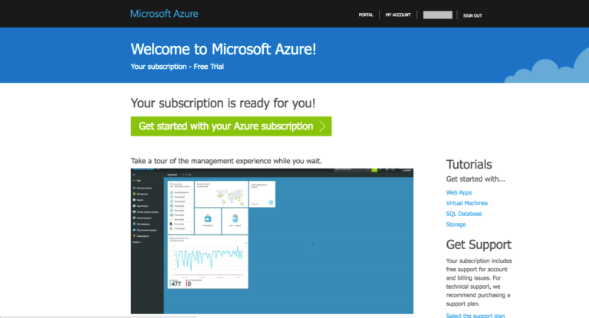
Within a few seconds, your account will be ready. That’s it! Your Microsoft Azure account has been created.
To continue, click the “My Account” link at the top right corner or go straight to the Microsoft Azure Portal:
https://portal.azure.com/

Slide 39
Azure Subscription Overview

Slide 40
Subscription Principles
Subscriptions are…
Administrative security boundary
Support RBAC delegation
A billing unit
Logical limit of scale
First container that you create
Considerations
Subscriptions do not cost anything
Each subscription has its own admins, although a single account can be an admin in multiple subscriptions
Are global

Slide 41
Initially a subscription was the administrative security boundary of Microsoft Azure. With the advent of Azure Resource Management (ARM) environment, a subscription now has two administrative models. Service Management and Azure Resource Management. With ARM the subscription is no longer needed as an administrative boundary. ARM provides a more granular Roles Based Access Control (RBAC) model for assigning administrative rights at the resource level. RBAC is currently being released in stages, 32 new roles have been released and user defined roles is coming in a future release. There will be some complexity during the coexistence of the service management and resource management environments and will need to be carefully considered.
A subscription additionally forms the billing unit. Services charges are accrued to the subscription currently, as part of the new Azure Resource Management model it will be possible to roll up costs to a resource group. A standard naming convention for Azure resource object types can be used to manage billing across projects teams, business units, or other desired view.
A logical limit of scale by which resources can be allocated, these limits include both hard and soft caps of various resource types (like 10,000 compute cores /subscription) and are changing as capacity and capabilities are updated within Azure. Scalability will continue to be a function of subscriptions and therefore is a key element to understand how the Subscription strategy will account for growth as consumption increases.

Slide 42
Containers and Resources
Subscription is the top level container
Create Resource groups in the subscription
Place resources within the resource groups

Slide 43
Azure Governance Layers
Functional
Business Division
Geographic
Functional
Enterprise
Enterprise
Enterprise
Enterprise
Departments
[optional]
Finance
Marketing
Auto
Aerospace
North America
Europe
Accounts
Joe Smith
Jane Doe
Lin Chi
Adi Krishnan
Ted Bear
Grace Ma
Subscriptions
Project 1 Dev
Project 1 Test
Production Web Sites
Application 1
Application 2
Application 3
Project 1
Project 2
Project 3
The Azure governance layers, roles, portals etc.. provide the technical means that can be used in different ways. Some customer prefer to use functional differentiation, others business division based or geographical or even a combination.
Notes:
The Azure governance layers, roles, portals etc.. provide the technical means that can be used in different ways. Some customer prefer to use functional differentiation, others business division based or geographical or even a combination.

Slide 44
Management Portals
Portal | Location | Purpose
Enterprise Portal | https://ea.azure.com/ | Manage access Manage accounts Manage subscriptions View price sheet View usage summary Manage usage & lifecycle email notifications Manage Authentication Types
Account Portal | https://account.windowsazure.com | Edit subscription details Enroll in or enable Preview features
Management Portal | https://manage.windowsazure.com or https://portal.azure.com | Provision/de-provision Azure services Manage co-administrators on subscriptions Open support tickets for issues within the subscription

Slide 45
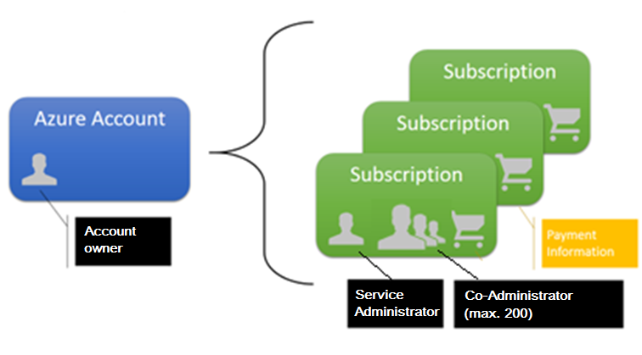

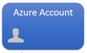
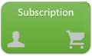
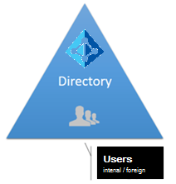
Azure governance structure
The three portals serve different audiences and needs and provide administrative boundaries. This picture can be used to provide answers on how these portals are related to one another.
Enterprise portal
CLI / Custom
Azure Management Portal
Enterprise (enrollment)
REST API’s
Azure
RBAC
Account portal
Department
Department
Azure Resource Manager
Azure resources
Has
Associated

Slide 46
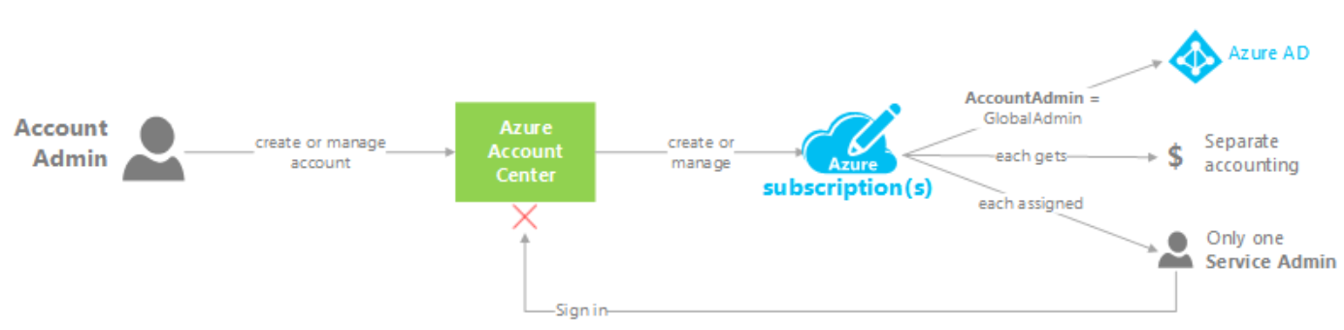
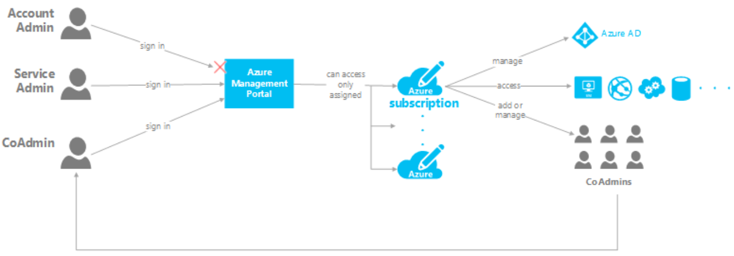
Account and Subscription Management
The below diagrams explain what the account admin, service admin and co-admin roles are used for, these roles can be assigned to one or multiple identities.
46

Slide 47
Subscription Considerations
Management approach
Single team or distributed
RBAC
Security requirements
Data or network security
Environments - Sandbox, Dev, Test, UAT, Pre-Prod, Prod
Connectivity requirements
Single point of ingress?
Multiple regions?
Application requirements
Data flow
Compliance

Slide 48
Subscription per Department (Customer Managed)
Each department contains different types of environments (e.g. Prod, Non-Prod). Virtual Networks will wrap the different environments for traffic separation. Subnets will be created within each environment to establish required security isolation zones between applications.
Simplified Subscription Management
Cons
Granular RBAC model required
Low ExpressRoute Circuit Costs
No Vnet Subscription Limit
Subscription Limit Issues in Cores, Storage, NSGs
Complex Vnet addressing
Mistake in management will affect all environments
Pros

Slide 49
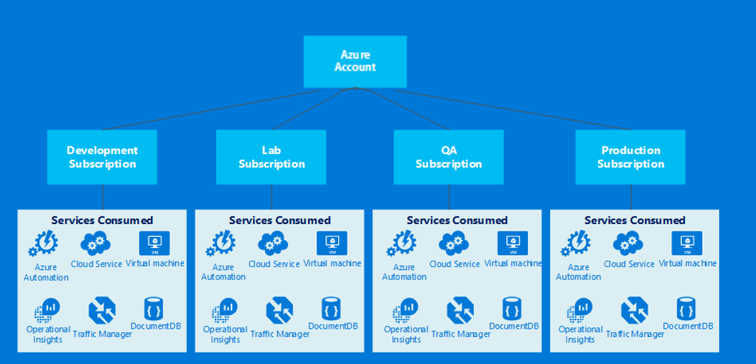
Subscription per Environment (Customer Managed)
Each environment contains the different types of applications. Virtual Networks will wrap the different applications for traffic separation. Subnets will be created within each environment to establish required security isolation zones among application tiers.
Pros
Cons
New ExpressRoute circuit required per 10th application, or ER Premium
Shared ExpressRoute circuit model
Requires medium capacity planning
Max of 10 dedicated circuits per subscription, max of 100 applications
Low Vnet subscription limit issues (Limit Per 100th application)
Vnet address spaces can be tailored per application
Granulated Application RBAC model

Slide 50
Subscription per Application (Customer Managed)
Each application contains the different tiers. Virtual Networks will wrap the different tiers for traffic separation. Subnets will be created within each tier to establish required security isolation zones.
Pros
Cons
Minimal Capacity Planning
Per Application RBAC model
Management Complexity
Minimal Subscription limit issues.
Increased Network Costs

Slide 51
Networking Considerations
Enterprise Enrollment
Department A
Department B
Account A
Account B
Account C
Subscription 1
Subscription 2
Subscription 3
Subscription 4
Region
Region
Vnet 1
Vnet 2
Vnet 3
Vnet 4
Vnet 5
Vnet 6
Express Route Circuit
Express Route Circuit
Express Route Circuit
Express Route Circuit
Express Route Circuit

Slide 52
See dashed lines ------- in above diagram
1.You MUST create or use the Azure Dynamic Routing VPN gateways to connect your virtual networks. Static Routing VPN gateways are NOT supported for VNet-to-VNet.
2.For each virtual network, you can connect up to 10 “networks”; i.e., both virtual networks and on premises sites combined cannot exceed 10.
3.You need to ensure that the address prefixes don’t overlap among all the connected networks.
4. VNet-to-VNet feature works across regions and subscriptions – same or different regions, single or across subscriptions.
You can link up to 10 virtual networks to an ExpressRoute circuit. All virtual networks must be in the same continent as the ExpressRoute circuit.
You can link a single virtual network with up to 4 ExpressRoute circuits. All ExpressRoute circuits must be in the same continent. They can be ordered through different service providers and in different locations. (https://msdn.microsoft.com/en-us/library/azure/dn606292.aspx )

Slide 53
Multiple Subscriptions = Complexity
Multiple Azure subscriptions means:
Duplicate provisioning and management: IP Address space, network circuits, gateways, vNets, Subnets, NSGs, routing
More connectivity to manage
More security to manage
More identities to manage
Potentially more ExpressRoute circuits to buy
Multiple subscription are going to happen though, so design for it

Slide 54
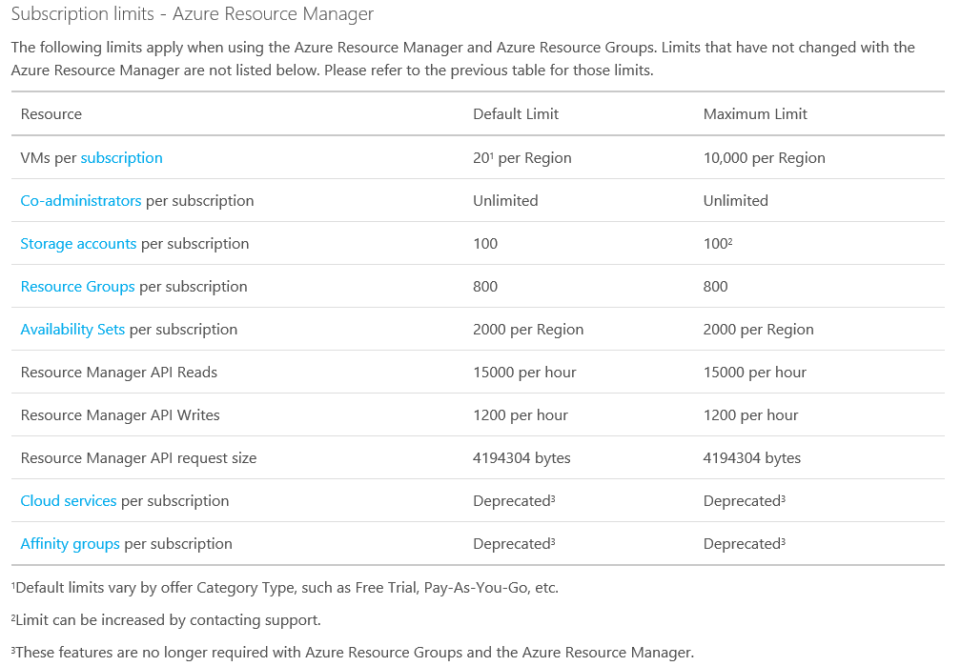
Azure Subscription Limits
http://azure.microsoft.com/en-us/documentation/articles/azure-subscription-service-limits/

Slide 55
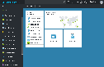
Azure Roles versus Management
Azure Active Directory
Active Directory
Application
Customer Manages
the OS and app config
Customer provisions
and manages Azure
Object
OS
Virtual hardware
Physical hardware
Microsoft manages
the platform and SLA
Fabric

Slide 56
Resource Groups and Hierarchy
Subscription
Resource Group
Resource
Resource
Resource Group
Resource
Resource

Slide 57
Azure Resource Overview

Slide 58
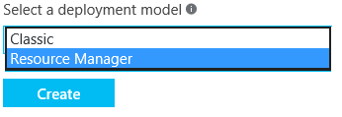
Role Considerations
Azure Subscriptions have two administrative models:
Classic
(v1)
Azure Service Management (ASM)
Resource Manager (v2)
Azure Resource Manager (ARM)
Notes:
Azure Resource Management (ARM) environment, a subscription now has two administrative models: Service Management and Azure Resource Management. With ARM the subscription is no longer needed as an administrative boundary. ARM provides a more granular Roles Based Access Control (RBAC) model for assigning administrative rights at the resource level. RBAC is currently being released in stages, 22 new roles have been released and user defined roles is coming in a future release. There will be some complexity during the coexistence of the service management and resource management environments and will need to be carefully considered.

Slide 59
Azure Resource Management (ARM) environment, a subscription now has two administrative models: Service Management and Azure Resource Management. With ARM the subscription is no longer needed as an administrative boundary. ARM provides a more granular Roles Based Access Control (RBAC) model for assigning administrative rights at the resource level. RBAC is currently being released in stages, 22 new roles have been released and user defined roles is coming in a future release. There will be some complexity during the coexistence of the service management and resource management environments and will need to be carefully considered.
Resources in Azure
Classic (v1)
Multiple objects combined into a single manageable instance
Must connect to a classic network infrastructure
Resource Manager (v2)
Each object a separately manageable
Must connect to a RM network infrastructure
All new development focused here

Slide 60
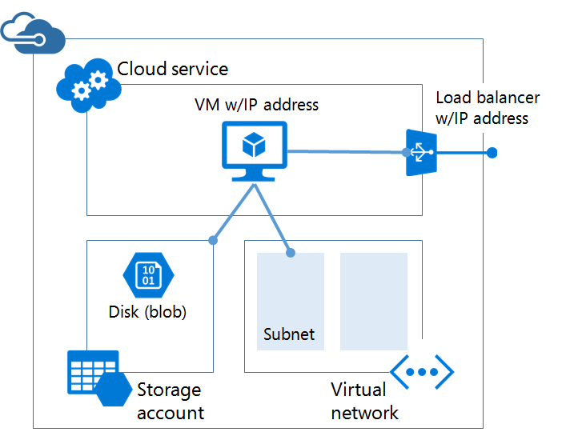
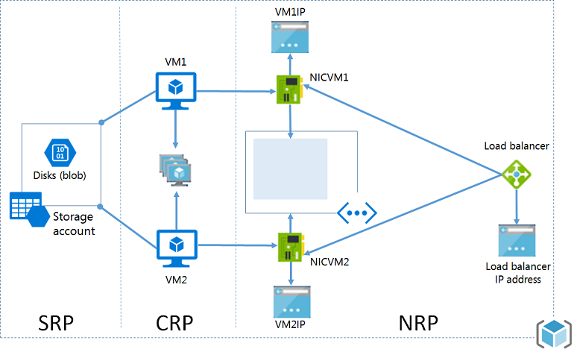
Azure Resource Manager
Classis (ASM)
ARM with RPs

Slide 61
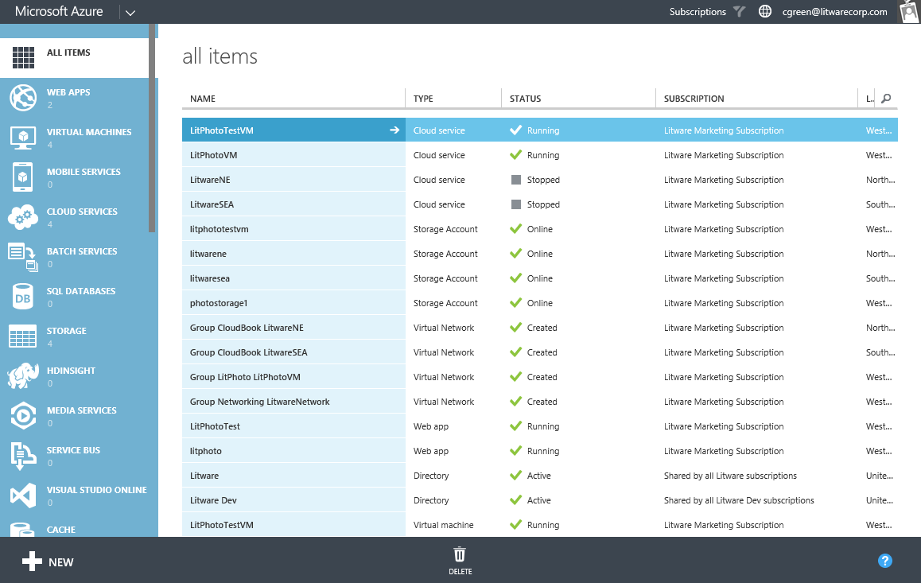
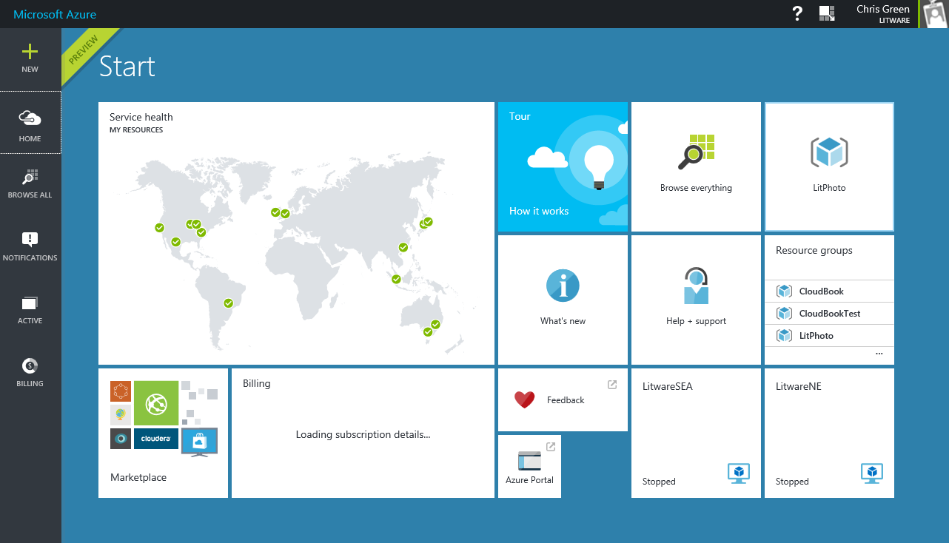
Portal and APIs
Feature | manage.windowsazure.com | portal.azure.com / ARM
Granularity | Subscription | Subscription, resource group, resource
Principal | User | User, directory group, application
Roles | Full control (or no access) | 30+ Built-in roles Custom roles

Slide 62
Resource Groups
Tightly coupled containers of multiple resources of similar or different types
Every resource *must* exist in one and only one resource group
Resource groups can span regions
Nesting of Resource Groups not supported
Only Subscription Owners can create resource groups
RESOU
R
CE G
R
OUP

Slide 63
Azure Resource Manager
Describe
Deploy
Control
RESOURCE
GROUP
Azure Resource Manager
Azure Resource Manager
App
Database
Compute
Network
Storage
MICROSOFT AZURE STACK
MICROSOFT AZURE

Slide 64
Resource Group Lifecycle
Question:
Should these resources be in the same group or a different one?
Hint:
Do they have common lifecycle and management?
Answer:
Up to you.

Slide 65
Azure RBAC Overview

Slide 66
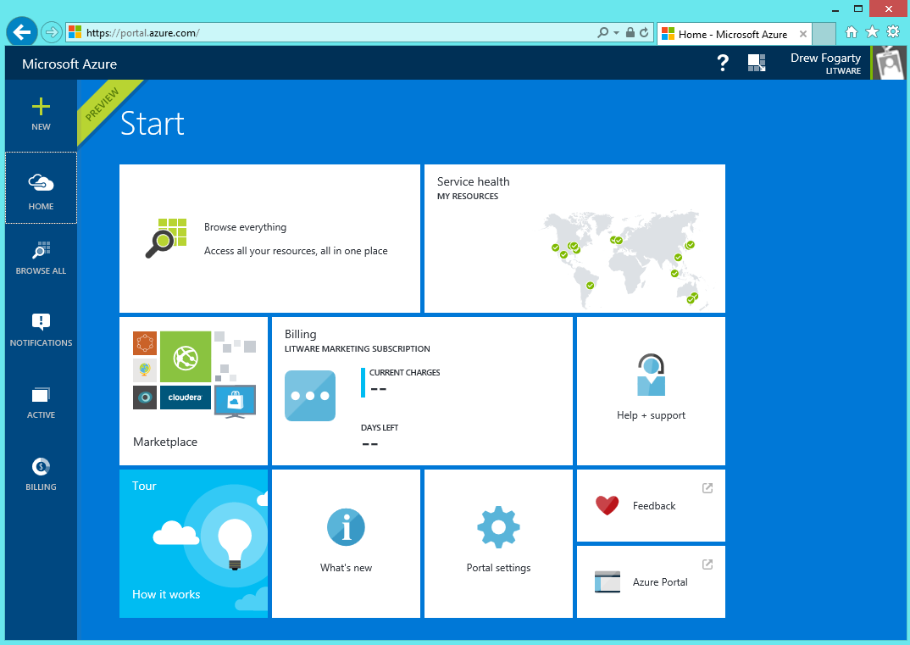
Least Privilege as a Model
Goal
Users can do the tasks their job requires
But no more than that
Best practices
Use the portal and ARM API
Assign the right role
Use resource groups

Slide 67
Role Based Access Control
Users
Authentication
& Authorization
Groups
Azure Resources in Resource Groups
Service Principals
Azure Active Directory
Azure Subscription

Slide 68
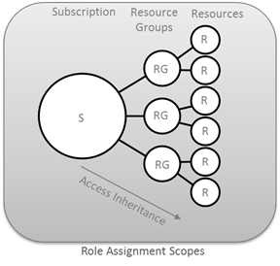
ARM Hierarchy and RBAC Roles
ARM provides a more granular Roles Based Access Control (RBAC) model for assigning administrative rights at the resource level.
Owner
Can perform all management operations for a resource and its child resources including access management and granting access to others.
Contributor
Can perform all management operations for a resource including create and delete resources. A contributor cannot grant access to other.
Reader
Has read-only access to a resource and its child resources. A reader cannot read secrets.
Notes:
There are thirty-two built-in Azure RBAC roles for controlling access to Azure resources:
The Owner can perform all management operations for a resource and its child resources including access management or granting access to others.
The Contributor can perform all management operations for a resource including create and delete resources. A contributor cannot grant access to others.
The Reader has read-only access to a resource and its child resources. A Reader cannot read secrets.

Slide 69
Role Based Access Control

Slide 70
Key RBAC Concepts
Role Definitions
describes the set of permissions (e.g. read actions)
can be used in multiple assignments
Role Assignments
associate role definitions with an identity (e.g. user/group) at a scope (e.g. resource group)
always inherited – subscription assignments apply to all resources

Slide 71
RBAC - Granular Scopes
/subscriptions/{id}/resourceGroups/{name}/providers/…/sites/{site}
subscription level – grants permissions to all resources in the sub
resource group level – grants permissions to all resources in the group
resource level – grants permissions to the specific resource

Slide 72
Roles for Azure subscription resources
Three primary roles:
Owner, Contributor, Reader
Permissions on all Azure resources
30+ resource-specific roles
Website contributor, Virtual machine contributor, etc.
Permissions scoped to resources and actions typically required by customers
Will add more as new Azure resources come online
Custom roles
Allows customers to take existing actions and create a custom RBAC role
Role must be loaded into each subscription
https://azure.microsoft.com/en-us/documentation/articles/role-based-access-built-in-roles/

Slide 73
Built-in Roles
BUILT-IN ROLE | ACTIONS | NOT ACTIONS
Owner (allow all actions) | *
Contributor (allow all actions except writing or deleting role assignments) | * | Microsoft.Authorization/*/Write, Microsoft.Authorization/*/Delete
Reader (allow all read actions) | */Read

Slide 74
Virtual Machine Contributor
Actions | Access
Microsoft.Storage/storageAccounts/read | Read storage accounts
Microsoft.Storage/storageAccounts/listKeys/action | List storage account keys
Microsoft.Network/virtualNetworks/read | Read virtual networks
Microsoft.Network/virtualNetworks/subnets/join/action | Join virtual network subnets
Microsoft.Network/loadBalancers/read | Read load balancers
Microsoft.Network/loadBalancers/backendAddressPools/join/action | Join load balancer backend address pools
Microsoft.Network/loadBalancers/inboundNatRules/join/action | Join load balancer inbound NAT Rules
Microsoft.Network/publicIPAddresses/read | Read network public IP addresses
Microsoft.Network/publicIPAddresses/join/action | Join network public IP addresses
Microsoft.Network/networkSecurityGroups/read | Read network security groups
Microsoft.Network/networkSecurityGroups/join/action | Join network security groups
Microsoft.Network/networkInterfaces/* | Create and manage network interfaces
Microsoft.Network/locations/* | Create and manage network locations
Microsoft.Network/applicationGateways/backendAddressPools/join/action | Join network application gateway backend address pools
Microsoft.Compute/virtualMachines/* | Create and manage virtual machines
Microsoft.Compute/availabilitySets/* | Create and manage compute availability sets
Microsoft.Compute/locations/* | Create and manage compute locations
Microsoft.Authorization/*/read | Read authorization
Microsoft.Resources/subscriptions/resourceGroups/read | Read subscription resource groups
Microsoft.Resources/subscriptions/resourceGroups/resources/read | Read subscription resource groups resources
Microsoft.Resources/subscriptions/resourceGroups/deployments/* | Create and manage subscription resource group deployments
Microsoft.Insights/alertRules/* | Create and manage Insights alert rules
Microsoft.Support/* | Create and manage support tickets

Slide 75
Resource Groups and Access Management
Marketing Subscription
Example
Best practices
Organize resources to meet access management requirements
Grant access at resource group when appropriate
Benefits
More granularity
Aligns with resource-specific roles
Ongoing manageability
Solution 1 Resource Group
Virtual machine
Storage account
Solution 2 Resource Group
Virtual machine
Storage account
SQL Server
Shared Infrastructure Resource Group
Virtual Network
Finance Subscription
Solution A Resource Group
Web app
SQL Server

Slide 76
Assigning Resource-specific Roles
Requirement
Map existing organizational roles (web, DB…) to their cloud solutions
Many Azure resources that work together are peers in the same resource group
Virtual machine and storage account, web app and AppInsights
To fully manage a resource, a user may also need to manage its related peers
Best Practice
Assign resource-specific role on the resource group
Alternative
Assign access to each resource individually

Slide 77
Example RBAC Assignment
Requirement (example)
User needs to manage “Web app A” and related resources such as “Application Insights B”
User shouldn’t manage “Virtual Machine C” or “Storage account D”
Best practice
Assign Web app contributor and Application Insights Component Contributor role on ‘Solution 1 resource group’
Alternative: Two assignments
Contributor role on ‘Virtual Web App” and
Application Insights Component Contributor role on “App Insights B”
Marketing Subscription
Solution 1 Resource Group
Web app A
Assigning role Web app contributor on Solution 1 resource group
Conveys permissions on web apps and Application Insights instances in the resource group
Does not convey permissions on virtual machines or storage accounts
Application Insights B
Virtual Machine C
Storage account D

Slide 78
Azure Active Directory Integration
Best practice
All organizational Azure subscriptions use the same Azure AD for access control.
I.e., don’t have each subscription in the organization relying on its own Default directory.
Benefits
Manageability
Compliance
Litware Azure AD
Marketing Subscription
Resource Group 1
Resource
Resource
Resource Group 2
Resource
Resource
Finance Subscription
Resource Group A
Resource
Resource

Slide 79
RBAC Audit Logs and Resource Management Locks
Role assignment changes are captured in events where the ResourceProviderName is Microsoft.Authorization.
Azure Resource Manager provides the ability to restrict operations on resources through resource management locks.
Resource locks are policies which enforce a lock level at a particular scope.

Slide 80
Azure Resource Manager Resource Locks

Slide 81
Resource Locks
Accidents happen. Resource locks help prevent them :)
Resource locks allow administrators to create policies which prevent write actions or prevent accidental deletion.

Slide 82
Key Concepts
Resource lock
Policy which enforces a "lock level" at a particular scope
Lock level
Type of enforcement; current values include CanNotDelete and ReadOnly
Scope:
The realm to which the lock level is applied. Expressed as a URI; can be set at the resource group, or resource scope.

Slide 83
Module 1 – Lesson 3 – Managing Azure with the Azure portal
Microsoft Azure Portal
• Browser based administration (https://portal.azure.com)
• Current portal that supports all Azure services
• Full support of ARM (Azure Resource Manager) resources
• Centralize view in one portal
• Personalize experience
• Fine grained access control
• Billing visibility
Azure’s old/classic portal (ASM – Azure Service Manager) was located at: https://manage.windowsazure.com

Slide 84
Module 1 – Lesson 4 - Managing Azure with Windows PowerShell
Azure PowerShell
• Windows PowerShell is a scripting platform
• Azure has PS modules for Azure cmdlets
• Automating IT processes with Scripts (Reusability)
• Part of larger deployments (Devops?)
• There are various PowerShell modules for Azure (we will focus on the AzureRM module)
Azure PowerShell module browser: https://docs.microsoft.com/en-us/powershell/module/ (look for AzureRM PowerShell)
Azure PS is an open-source project: https://github.com/Azure/azure-powershell/

Slide 85
How to get Azure PowerShell
1. Web platform installer - https://azure.microsoft.com/en-us/downloads/
a) Will get the latest version for you
b) It will take care of all the prerequisites
2. The PowerShell Gallery – depends on PowerShellGet module
a) Depends on the Windows Management Framework (WMP) : https://www.microsoft.com/enus/download/details.aspx?id=54616
b) If you are on Windows 10, you are all set to do this. If you are not then download the WMP.
c) For all other editions download WMP and take it from there
3. Microsoft Windows Installer package (MSI)
4. Azure Cloud Shell on the Azure Portal (the easiest!)

Slide 86
Azure PowerShell Installation
We will be using The PowerShell gallery
Check if it is already installed and if it is then which version it is:
Get-Module AzureRM -ListAvailable | Select-Object -Property Name,Version,Path
Install it :
Install-Module -Name AzureRM
Update it (if you need to in future):
Update-Module -Name AzureRM
Modules will be located at: C:\Program Files\WindowsPowerShell\Modules
Azure PowerShell Login and subscription access
You must Authenticate to access the Azure Subscriptions
1. AD Authentication
2. Certificate based authentication (https://docs.microsoft.com/en-us/azure/azure-resource-manager/resourcegroup-
authenticate-service-principal)
Using AD authentication:
Connect to Azure with an authenticated account:
Add-AzureRmAccount
Get the current context:
Get-AzureRmContext

Slide 87
Search for PowerShell on search tab as below and you will get below options

Slide 88
Choose Windows PowerShell ISE and right click to Run as administrator

Slide 89
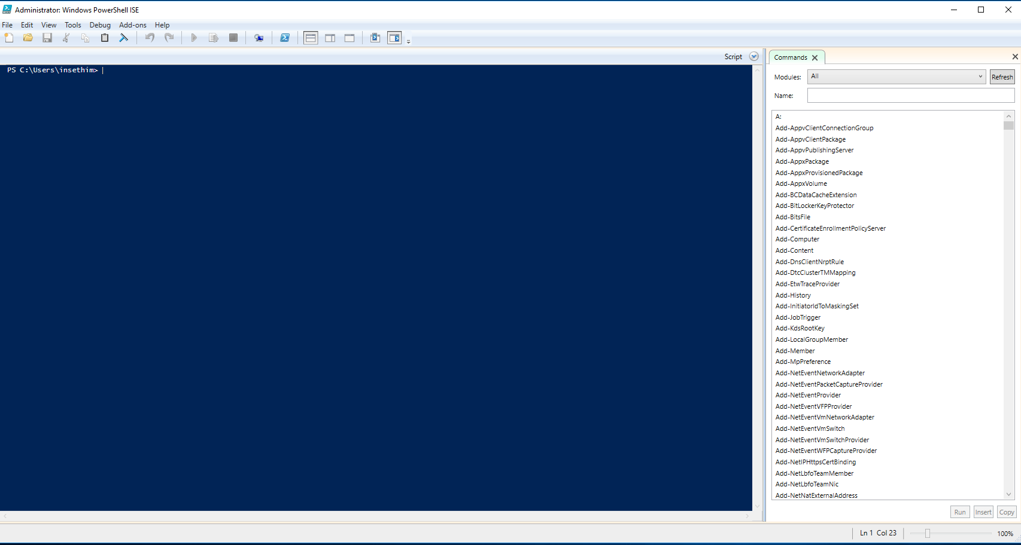
The PowerShell ISE will look like below after run as administrator

Slide 90
This PowerShell is not having azure modules to run azure commands, so we need to install azure module in the PowerShell.

Slide 91
While installing Azure Module in PowerShell, Pls type all below commands shown in pic and click on yes button
get-module
$psversiontable.psversion
Install-Module -Name AzureRM

Slide 92
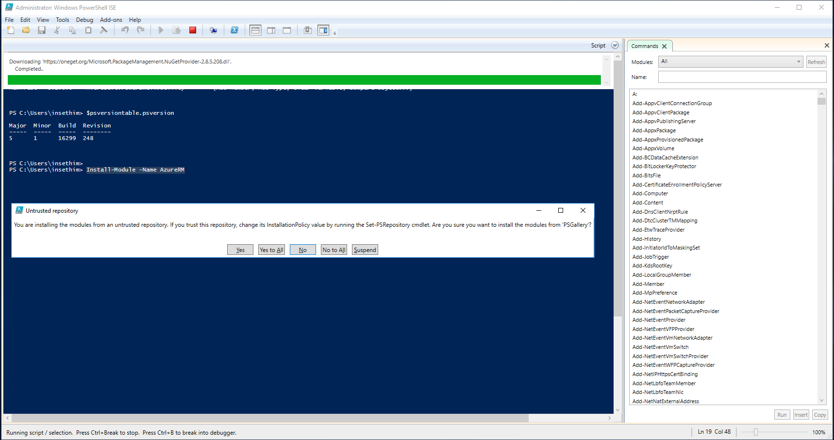
After "Install-Module -Name AzureRM" command it will download the Azure Module from internet and we need to select "Yes to all" button

Slide 93
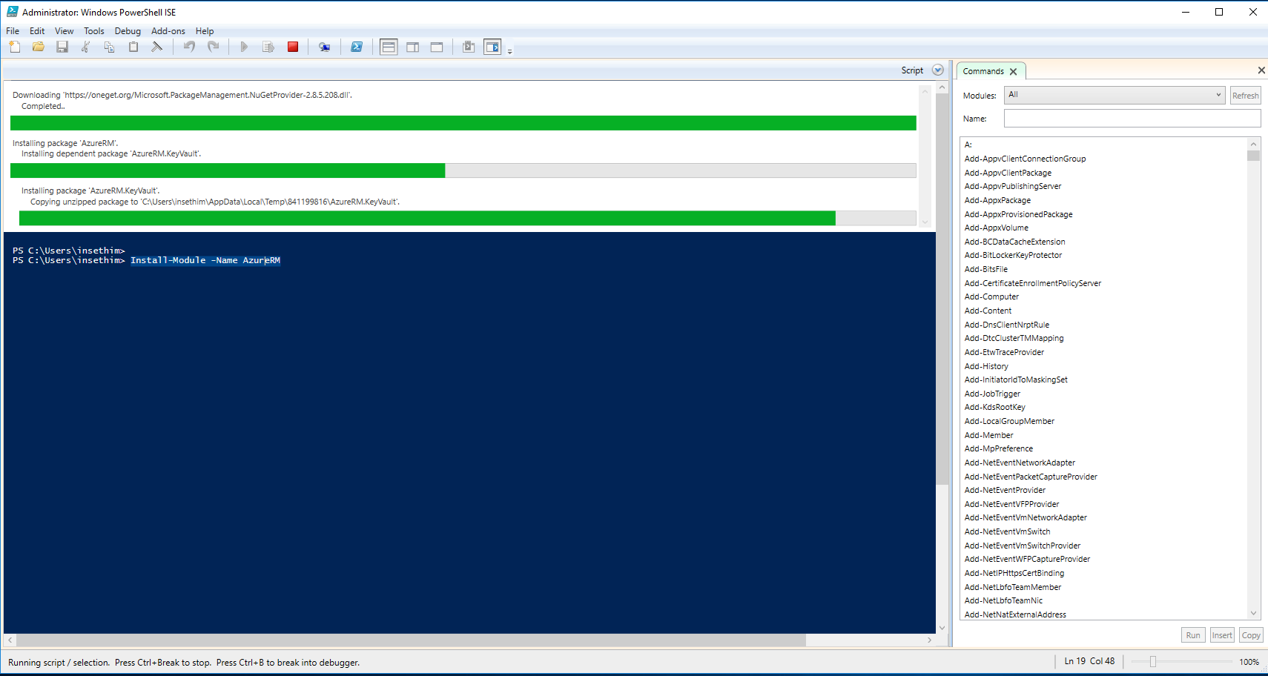
After clicking "yes to all" it will install all the packages of Azure Module on PowerShell as shown below

Slide 94
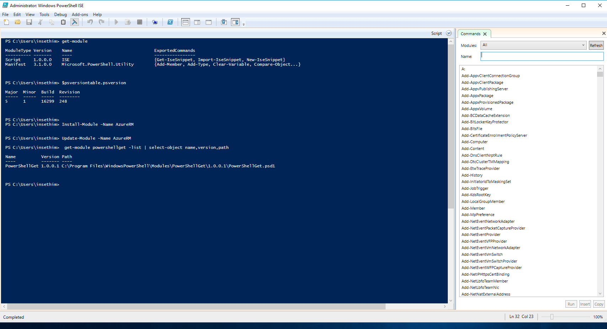
Check if it is already installed and if it is then which version it is: get-module powershellget -list | select-object name,version,path

Slide 95
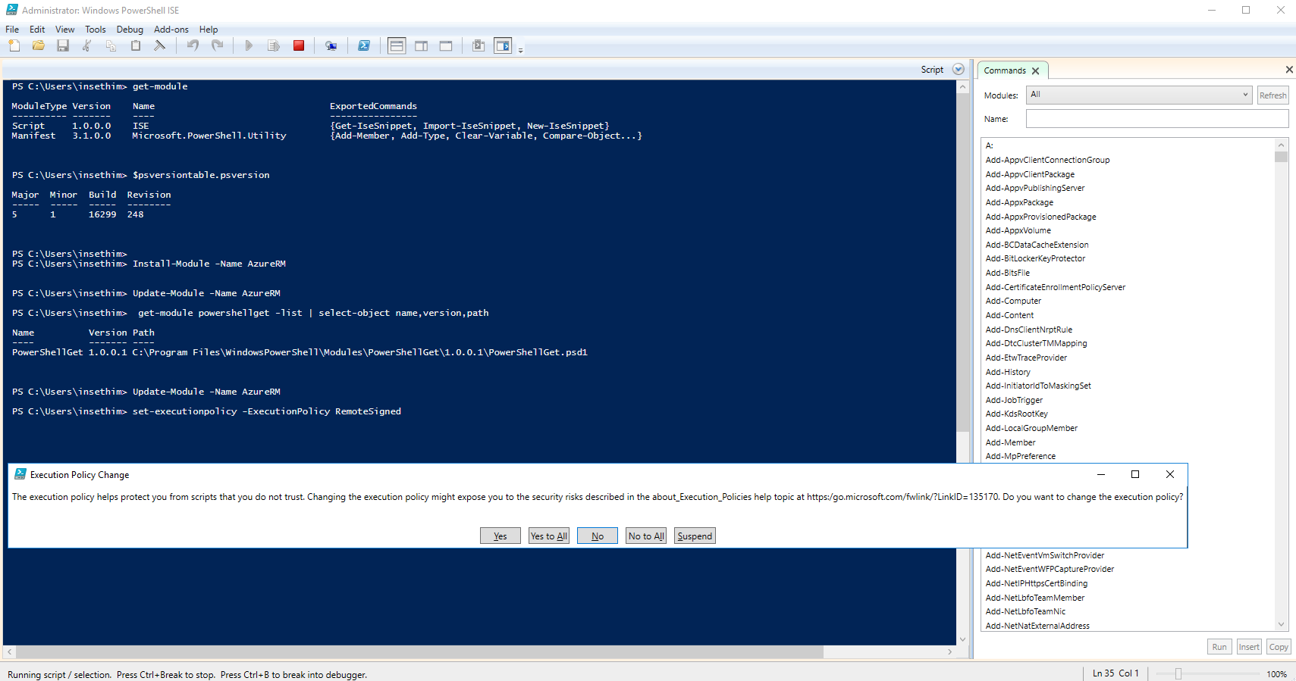
Set the permission for powershell command to run locally : set-executionpolicy -ExecutionPolicy RemoteSigned
And then select “yes for all”

Slide 96
Then type "import-module azurerm" command to use azure commands on this PowerShell and after which search for azure command which will show on right hand side of PowerShell

Slide 97
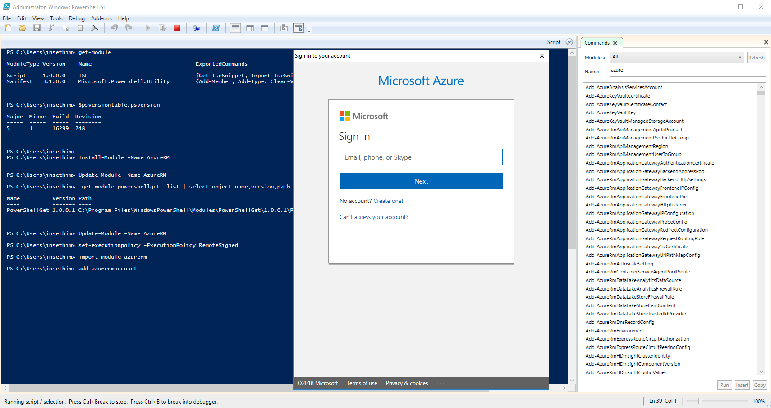
Connect to Azure with an authenticated account: Add-AzureRmAccount

Slide 98
After successful login with authenticated account, we will get below details

Slide 99
Module 1 - Lesson 5 - Managing Azure with Azure CLI
Azure CLI
• From previous lesson we know that Azure PowerShell is available from Linux
• But you may prefer something more Linux native to harmonize with existing tools
• Azure CLI can be used both from Windows and Linux
• Azure first had CLI 1.0 (based on node.js). Also was known as XPLAT-CLI. It supports both Azure classic model
and ARM.
• Azure CLI 2.0 (based on Python) is the latest CLI and supports only ARM
Getting Azure CLI 2.0
Linux: https://docs.microsoft.com/en-us/cli/azure/install-azure-cli?view=azure-cli-latest
Windows: https://azurecliprod.blob.core.windows.net/msi/azure-cli-latest.msi

Slide 100
Azure CLI 2.0 install using apt on Linux
# Modify the source list to get Microsoft packages
AZ_REPO=$(lsb_release -cs)
echo "deb [arch=amd64] https://packages.microsoft.com/repos/azure-cli/ $AZ_REPO main" | \
sudo tee /etc/apt/sources.list.d/azure-cli.list
# Install Azure CLI 2.0
sudo apt-key adv --keyserver packages.microsoft.com --recv-keys 52E16F86FEE04B979B07E28DB02C46DF417A0893
sudo apt-get install apt-transport-https
sudo apt-get update && sudo apt-get install azure-cli
Azure CLI 2.0 authenticate account
Connect to Azure subscription
$ az login

Slide 101
Module 1 – Lesson 6 - Overview of Azure deployment models
Azure deployment models
1. Azure Classic (ASM) deployment model - traditional approach
2. Azure Resource Manager (ARM) deployment model – latest approach
Azure Resource Manager (ARM)
1. Latest deployment model from Azure
2. A mechanism to handle all Azure “resources” as a related and interdependent parts of a single
entity rather than individually
3. Azure Resource Manager provides security, auditing, and tagging features to help manage
resources after deployment
4. Resource Manager provides a consistent management layer for the tasks performed through
Azure PowerShell, Azure CLI, Azure portal, REST API, and development tools. Use the tool that
best works for you and the purpose.

Slide 102
Azure Resource Manager (ARM) – Getting to know the terms
1. Resource – A manageable item in Azure. It is the elementary building block for Azure Services. E.g., virtual
machine, virtual network, storage account and many more.
2. Resource Group – A logical container that holds related resources. Typically for a solution.
3. Resource Provider - Think of it as a service that providers the “resource” that can be deployed and managed
through Resource Manager. It also offers operations for working with the resources that are deployed. E.g., For
a Virtual Machine the provider is Microsoft.Compute . Typical format of the provider is {resourceprovider}/{resource-type}
4. Tags – Resource Manager provides tagging feature that can be applied to individual resources or resource
groups or subscriptions. It can categorize resources according to requirements for managing or billing or
audit, or access. Resources do not need to reside in the same resource group to share a tag
5. Resource Manager Templates - A JavaScript Object Notation (JSON) file that defines one or more resources
to deploy to a resource group.
6. RBACs, Policies and Locks
Azure Resource Manager (ARM) – Resources
• The most elementary building blocks of Azure services
• Resources are provided by “Resource Providers”
• Actions can be performed on resources through resource providers. Done through interfaces or APIs
• Every resource needs to be part of a Resource Group – Resource Groups are created first before resources are created

Slide 103
Azure Resource Manager (ARM) – Resource Groups
• A logical container for resources
• Resources in the resource groups share the same lifecycle and can be managed together
• Permissions can be delegated on the same Resource Group through RBAC
• Costs, Audits, Utilization etc. can be measure on a Resource Group level
• A resource can be only be in one resource Group at a time
• How to allocate resources in a Resource Group is based on what works for you and your
organization. Keeping all limits in mind.
Azure Resource Manager (ARM) – ARM Templates
• A JavaScript Object Notation (JSON) file that defines one or more resources to deploy to a
resource group. It defines the infrastructure and configuration of the Azure solution
• The template can be used to deploy the resources consistently and repeatedly
• ARM templates have a declarative syntax. “Here is what I want to create” rather than “Go create it
this way”.
• When a solution is created from the portal, a deployment template is automatically created

